Slide 1
Introduction of Cost Accounting
Meaning of Cost Accounting
Cost accounting is concerned with recording, classifying and summarizing costs for determination of costs of products or services, planning, controlling and reducing such costs and furnishing of information to management for decision making.

Slide 2
Meaning of Cost
Cost is the amount of resources given up in exchange for some goods and services. The resource given up are money and money’s equivalent expressed in monetary units.

Slide 3
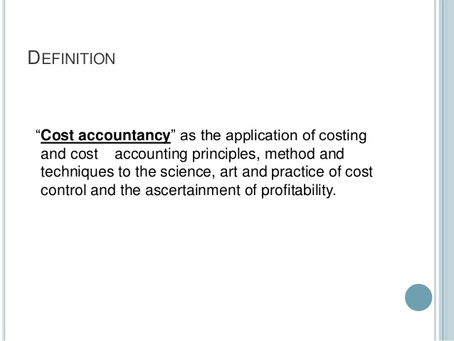
Definition of Cost Accountancy

Slide 4
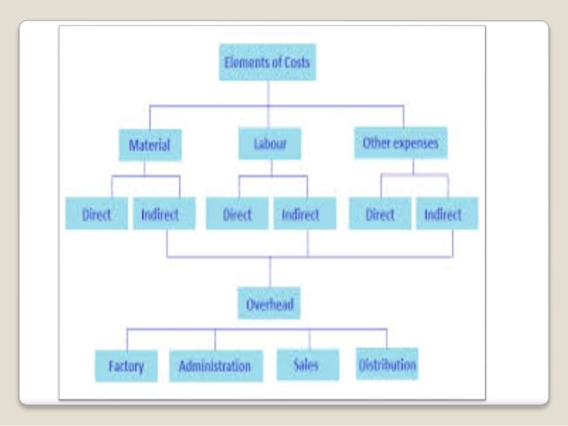
Elements of Cost

Slide 5
Direct/Indirect
Illustration
Say a toy manufacturing unit procures plastic as a raw material. The cost of plastic is direct material cost. The costs incurred in the packing and transportation of the same is the indirect material cost. Similarly, the labour cost for the production of toys is the direct labour cost whereas the salary of the production supervisor will be indirect labour cost.

Slide 6
Classification of Cost Accounting
On the Basis of:
Nature
Function
Variability
Normality
Managerial Decision Making
Direct and indirect
Controllability
Time
Planning and Control

Slide 7
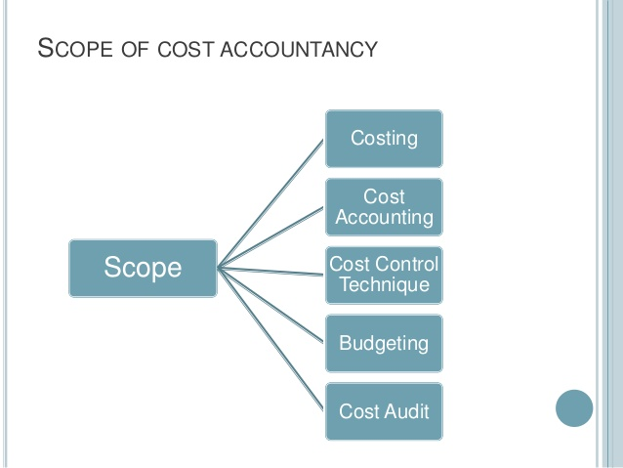
Scope of Cost Accounting

Slide 8
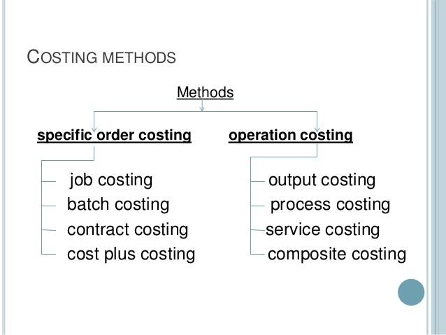
Methods of Costing

Slide 9
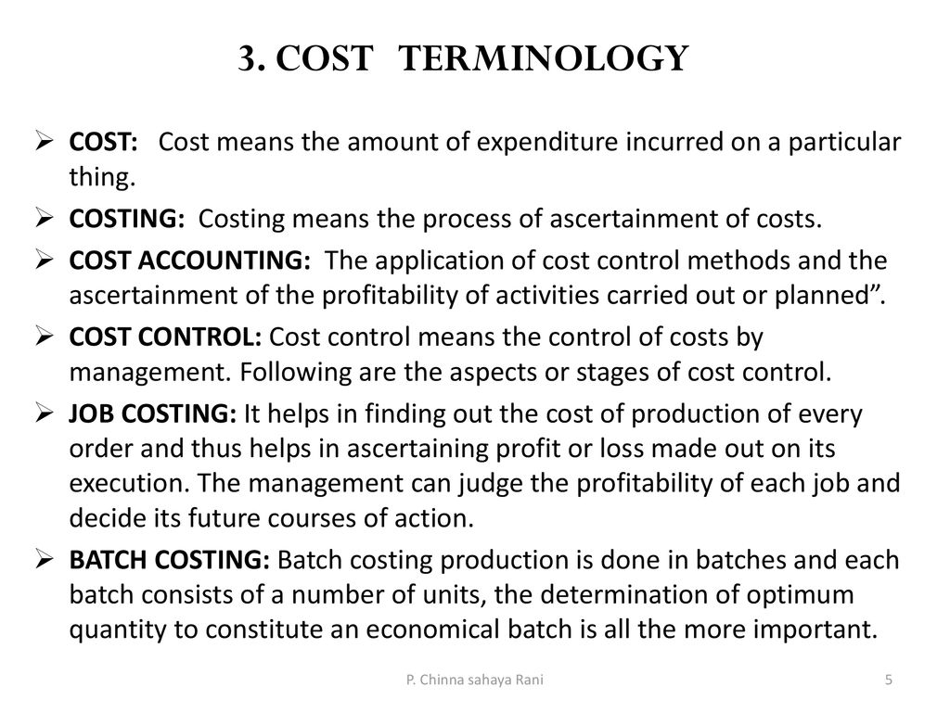
Cost Terminology

Slide 10
C -Terms in Cost Accounting
Cost Unit
Cost Centre
Cost Estimation
Cost Allocation
Cost Apportionment
Cost Reduction
Cost Control

